Slide 1
Human-Computer Interection
Md. Fazlul Karim Patwary
Associate Professor, IIT, JU

Slide 2
WHY HUMAN–COMPUTER INTERACTION?
Human–computer interaction researches the design and use of computer technology, focused on the interfaces between people and computers.
Human–computer interaction has only been in widespread use since the early 1980s.
Research that has influenced the development of HCI is called information science and technology.

Slide 3
Connern of HCI
Systems analysis has traditionally concerned itself with the influence of technology in the workplace, and fitting the technology to the requirements and constraints of the job.
HCI involves the design, implementation and evaluation of interactive systems in the context of the user’s task and work.
Notes:
Introduction of technology has had a profound effect on the way that information can be stored, accessed and utilized and, consequently, a significant effect on the organization and work environment.

Slide 4
User
By user we may mean
an individual user,
a group of users working together, or
a sequence of users
in an organization, each dealing with some part of the task or process.
The user is whoever is trying to get the job done using the technology.

Slide 5
Computer
By computer we mean
any technology ranging from the general desktop computer to a large-scale computer system,
a process control system or
an embedded system.
The system may include non-computerized parts, including other people.

Slide 6
Interection
By interaction we mean
any communication between a user and computer, be it direct or indirect.
Direct interaction involves a dialog with feedback and control throughout performance of the task.
Indirect interaction may involve batch processing or intelligent sensors controlling the environment.
The important thing is that the user is interacting with the computer in order to accomplish something.

Slide 7
Skill needed of an Effective Design
HCI is undoubtedly a multi-disciplinary subject. The ideal designer of an interactive system would have expertise in a range of topics:
Psychology and cognitive science - to give his knowledge of the user’s perceptual, cognitive and problem-solving skills.
Ergonomics - for the user’s physical capabilities.
Sociology - to help her understand the wider context of the interaction.
Computer science and engineering – to be able to build the necessary technology.
Business - to be able to market it.
Graphic design - to produce an effective interface presentation;.
Technical writing - to produce the manuals.

Slide 8
Skill needed of an Effective Design?
It is not possible to design effective interactive systems from one discipline in isolation. Input is needed from all sides.
For example, a beautifully designed graphic display may be unusable if it ignores dialog constraints or the psychological limitations of the user.

Slide 9
Our Concern
People
Computers and
Tasks that are performed
usability
The system must support the user’s task.
If the system forces the user to adopt an unacceptable mode of work then it is not usable.

Slide 10
Myth
There are three ‘use’ words that must all be true for a product to be successful; it must be:
useful – accomplish what is required: play music, cook dinner, format a document;
usable – do it easily and naturally, without danger of error, etc.;
used – make people want to use it, be attractive, engaging, fun, etc.

Slide 11
Craft
Design of interactive systems and the user interface in particular, is a science or a craft discipline.
The most impressive structures, the most beautiful buildings, the innovative and imaginative creations that provide aesthetic pleasure, all require inventive inspiration in design and a sense of artistry, then the discipline is a craft discipline.

Slide 12
HCI
these structures also have to be able to stand up to fulfill their purpose successfully, and to be able to do this the architect has to use science. So it is for HCI.
HCI helps to built beautiful and/or novel interfaces are artistically pleasing and capable of fulfilling the tasks required.
We may call it as a marriage of art and science into a successful whole.

Slide 13
Why do we need to study on Human
The human the one whom computer systems are designed to assist. Alternatively we may call user.
The requirements of the user should therefore be our first priority. Why?
In order to design something for someone, we need to understand their capabilities and limitations.
We need to know if there are things that they will find difficult or, even, impossible.
It will also help us to know what people find easy and how we can help them by encouraging these things.

Slide 14
Why do we need to study on Human psychology?
Generally, human psychology is called cognitive psychology. One aspect of cognitive psychology affects on the use of computer systems:
how humans perceive the world around them,
how they store and process information and solve problems, and
how they physically manipulate objects.
So cognitive psychology closely related with designing and building interactive computer systems.

Slide 15
INPUT–OUTPUT CHANNELS
A person’s interaction with the outside world occurs through information being received and sent: input and output.
In an interaction with a computer the user receives information that is output by the computer, and responds by providing input to the computer – the user’s output becomes the computer’s input and vice versa.

Slide 16
INPUT–OUTPUT CHANNELS
A particular channel may have a primary role as input or output in the interaction, it is more than likely that it is also used in the other role.
For example, sight may be used primarily in receiving information from the computer, but it can also be used to provide information to the computer.
Which one is channel?

Slide 17
Human Sense
Input in the human occurs mainly through the senses and output through the motor control of the effectors. There are five major senses:
Sight / vision,
hearing,
touch,
Taste and
smell.
First three are the most important to HCI.
Notes:
In the interaction with the computer, the fingers play the primary role, through typing or mouse control, with some use of voice, and eye, head and
body position.

Slide 18
Human Sense
Similarly there are a number of effectors, including
the limbs,
fingers,
eyes,
head and
vocal system.
Notes:
Imagine using a personal computer (PC) with a mouse and a keyboard. The application
you are using has a graphical interface, with menus, icons and windows.
In your interaction with this system you receive information primarily by sight, from
what appears on the screen. However, you may also receive information by ear: for
example, the computer may ‘beep’ at you if you make a mistake or to draw attention
to something, or there may be a voice commentary in a multimedia presentation.
Touch plays a part too in that you will feel the keys moving (also hearing the ‘click’)
or the orientation of the mouse, which provides vital feedback about what you have
done. You yourself send information to the computer using your hands, either
by hitting keys or moving the mouse. Sight and hearing do not play a direct role
in sending information in this example, although they may be used to receive
information from a third source

Slide 19
Human Vision
Human vision is a highly complex activity with a range of physical and perceptual limitations, yet it is the primary source of information for the average person.
Visual perception into two stages:
the physical reception of the stimulus from the outside world, and
the processing and interpretation of that stimulus.

Slide 20
Human Vision
Physical properties of the eye and the visual system mean that there are certain things that cannot be seen by the human;
Interpretative capabilities of visual processing allow images to be constructed from incomplete information.
We need to understand both stages as both influence what can and cannot be perceived visually by a human being, which in turn directly affects the way that we design computer systems.

Slide 21
Human Vision
Eye: Vision begins with light. The eye is a mechanism for receiving light and transforming it into electrical energy. Light is reflected from objects in the world and their image is focused upside down on the back of the eye. The receptors in the eye transform it into electrical signals which are passed to the brain.
Notes:
The cornea and lens at the front of the eye focus the light into
a sharp image on the back of the eye, the retina. The retina is light sensitive and contains
two types of photoreceptor: rods and cones.

Slide 22
Human
Rods are highly sensitive to light and therefore allow us to see under a low level of illumination. However, they are unable to resolve fine detail and are subject to light saturation. This is the reason for the temporary blindness we get when moving from a darkened room into sunlight: the rods have been active and are saturated by the sudden light.
There are approximately 120 million rods per eye which are mainly situated towards the edges of the retina. Rods therefore dominate peripheral vision.

Slide 23
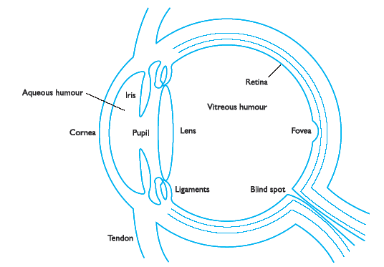
Human
.

Slide 24
Human
Cones are less sensitive to light than the rods and can therefore tolerate more light.
Three types of cone, each sensitive to a different wavelength of light. This allows color vision.
Eye has approximately 6 million cones, mainly concentrated on the fovea, a small area of the retina on which images are fixated.

Slide 25
Human: Eye
Retina also has two types specialized nerve cells called ganglion cells.
X-cells, which are concentrated in the fovea and are responsible for the early detection of pattern; and
Y-cells which are more widely distributed in the retina and are responsible for the early detection of movement.
The distribution of these cells means that, while we may not be able to detect changes in pattern in peripheral vision, we can perceive movement.

Slide 26
Human Eye: Visual perception
Information received by the visual apparatus must be filtered and passed to processing elements which allow us to recognize coherent scenes, disambiguate relative distances and differentiate color.
How we perceive size and depth, brightness and color, each of which is crucial to the design of effective visual interfaces.

Slide 27
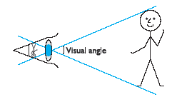
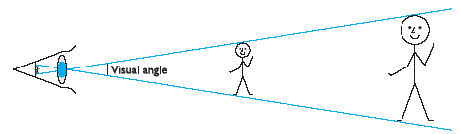
Human
Notes:
If we were to draw a line from the top of the object to a central point on the front
of the eye and a second line from the bottom of the object to the same point, the
visual angle of the object is the angle between these two lines. Visual angle is affected
by both the size of the object and its distance from the eye. Therefore if two objects
are at the same distance, the larger one will have the larger visual angle. Similarly,
if two objects of the same size are placed at different distances from the eye, the
furthest one will have the smaller visual angle. The visual angle indicates how much
of the field of view is taken by the object. The visual angle measurement is given in
either degrees or minutes of arc, where 1 degree is equivalent to 60 minutes of arc,
and 1 minute of arc to 60 seconds of arc.

Slide 28

Human

Slide 29
Human: Eye
Visual acuity is the ability of a person to perceive fine detail.
Person with normal vision can detect a single line if it has a visual angle of 0.5 seconds of arc. Spaces between lines can be detected at 30 seconds to 1 minute of visual arc.
These represent the limits of human visual acuity.

Slide 30
Laws of size Constancy
Given that the visual angle of an object is reduced as it gets further away, we might expect that we would perceive the object as smaller.
In fact, our perception of an object’s size remains constant even if its visual angle changes.
Same as a person’s height is perceived as constant even if they move further from us.
This is the law of size constancy, and it indicates that our perception of size relies on factors other than the visual angle.

Slide 31
Human:Eye
Two stages in vision
• physical reception of stimulus
• processing and interpretation of stimulus

Slide 32
Physical Reception
mechanism for receiving light and transforming it into electrical energy
light reflects from objects
images are focused upside-down on retina
retina contains rods for low light vision and cones for colour vision
ganglion cells detect pattern and movement

Slide 33
Interpreting the Signal
Size and depth
visual angle indicates how much of view object occupies (relates to size and distance from eye)
visual acuity is ability to perceive detail.
familiar objects perceived as constant size (in spite of changes in visual angle when far away)
cues like overlapping help perception of size and depth

Slide 34
Interpreting the Signal
Brightness
subjective reaction to levels of light
affected by luminance of object
measured by just noticeable difference
visual acuity increases with luminance as does flicker
Colour
made up of hue, intensity, saturation
cones sensitive to colour wavelengths
blue acuity is lowest
8% males and 1% females colour blind

Slide 35
Interpreting the Signal
The visual system compensates for:
movement
changes in luminance.
Context is used to resolve ambiguity
Optical illusions sometimes occur due to over compensation

Slide 36
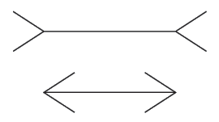
Muller-Lyer Illiusion
Which line is longer?
The two lines are the same length.
False application of the law of size constancy: top line appears like a concave edge,
bottom like a convex edge.
Former therefore seems further away than the latter and is therefore scaled to appear larger.

Slide 37
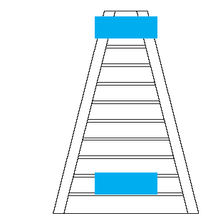
Ponzo Illiusion
Perception of size is not completely reliable.

Slide 38
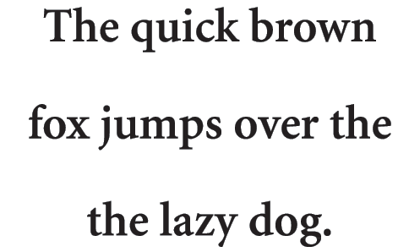
Proof-Reading Illiusion

Slide 39
Reading
Several stages:
visual pattern perceived
decoded using internal representation of language
interpreted using knowledge of syntax, semantics, pragmatics
Reading involves saccades and fixations
Perception occurs during fixations
Word shape is important to recognition
Negative contrast improves reading from computer screen

Slide 40
Hearing
Provides information about environment: distances, directions, objects etc.
Physical apparatus:
outer ear – protects inner and amplifies sound
middle ear – transmits sound waves as vibrations to inner ear
inner ear – chemical transmitters are released and cause impulses in auditory nerve
Sound
pitch – sound frequency
loudness – amplitude
timbre – type or quality

Slide 41
Hearing
Humans can hear frequencies from 20Hz to 15kHz
less accurate distinguishing high frequencies than low.
Auditory system filters sounds
can attend to sounds over background noise.
for example, the cocktail party phenomenon.

Slide 42
Touch
Provides important feedback about environment.
May be key sense for someone who is visually impaired.
Stimulus received via receptors in the skin:
thermoreceptors – heat and cold
nociceptors – pain
mechanoreceptors – pressure (some instant, some continuous)
Some areas more sensitive than others e.g. fingers.
Kinethesis - awareness of body position
affects comfort and performance.

Slide 43
Movement
Time taken to respond to stimulus: reaction time + movement time
Movement time dependent on age, fitness etc.
Reaction time - dependent on stimulus type:
visual ~ 200ms
auditory ~ 150 ms
pain ~ 700ms
Increasing reaction time decreases accuracy in the unskilled operator but not in the skilled operator.

Slide 44
Movement
Fitts' Law describes the time taken to hit a screen target:
Mt = a + b log₂(D/S + 1)
where: a and b are empirically determined constants
Mt is movement time
D is Distance
S is Size of target
targets as large as possible distances as small as possible

Slide 45
Memory
There are three types of memory function:
Sensory memories
Short-term memory or working memory
Long-term memory
Selection of stimuli governed by level of provocation.
Attention
Rehearsal

Slide 46
sensory memory
Buffers for stimuli received through senses
iconic memory: visual stimuli
echoic memory: aural stimuli
haptic memory: tactile stimuli
Examples
“sparkler” trail
stereo sound
Continuously overwritten

Slide 47
Short-term memory (STM)
Scratch-pad for temporary recall
rapid access ~ 70ms
rapid decay ~ 200ms
limited capacity - 7± 2 chunks

Slide 48
Long-term memory (LTM)
Repository for all our knowledge
slow access ~ 1/10 second
slow decay, if any
huge or unlimited capacity
Two types
episodic – serial memory of events
semantic – structured memory of facts, concepts, skills
semantic LTM derived from episodic LTM

Slide 49
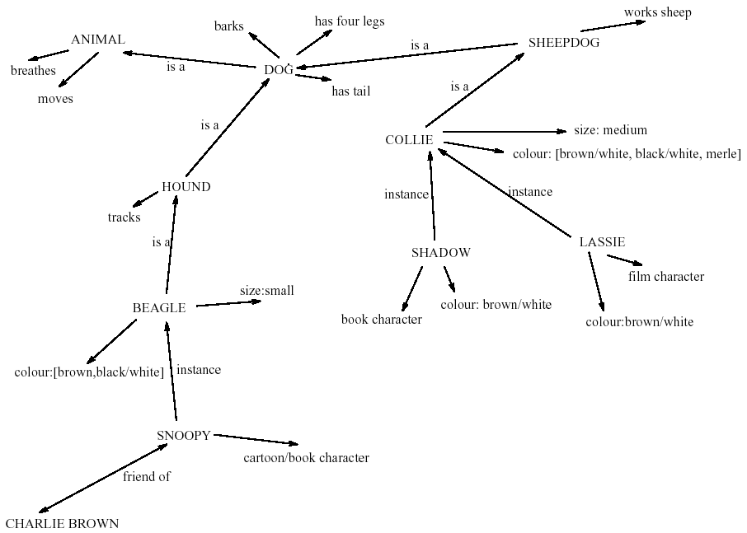
LTM - semantic network

Slide 50
Models of LTM - Frames
Information organized in data structures
Slots in structure instantiated with values for instance of data
Type–subtype relationships
DOG
Fixed
legs: 4
Default
diet: carniverous
sound: bark
Variable
size: colour
COLLIE
Fixed
breed of: DOG
type: sheepdog
Default
size: 65 cm
Variable
colour

Slide 51
Models of LTM - Scripts
Model of stereotypical information required to interpret situation
Script has elements that can be instantiated with values for context
Script for a visit to the vet
Entry conditions: dog ill
vet open
owner has money
Result: dog better
owner poorer
vet richer
Props: examination table
medicine
instruments
Roles: vet examines
diagnoses
treats
owner brings dog in
pays
takes dog out
Scenes: arriving at reception
waiting in room
examination
paying
Tracks: dog needs medicine
dog needs operation

Slide 52
Models of LTM - Production rules
Representation of procedural knowledge.
Condition/action rules
if condition is matched
then use rule to determine action.
IF dog is wagging tail
THEN pat dog
IF dog is growling
THEN run away

Slide 53
LTM - Storage of information
rehearsal
information moves from STM to LTM
total time hypothesis
amount retained proportional to rehearsal time
distribution of practice effect
optimized by spreading learning over time
structure, meaning and familiarity
information easier to remember

Slide 54
LTM - Forgetting
decay
information is lost gradually but very slowly
interference
new information replaces old: retroactive interference
old may interfere with new: proactive inhibition
so may not forget at all memory is selective …
… affected by emotion – can subconsciously `choose' to forget

Slide 55
LTM - retrieval
recall
information reproduced from memory can be assisted by cues, e.g. categories, imagery
recognition
information gives knowledge that it has been seen before
less complex than recall - information is cue

Slide 56
Thinking
Reasoning
deduction, induction, abduction
Problem solving

Slide 57
Deductive Reasoning
Deduction:
derive logically necessary conclusion from given premises.
e.g. If it is Friday then she will go to work
It is Friday
Therefore she will go to work.
Logical conclusion not necessarily true:
e.g. If it is raining then the ground is dry
It is raining
Therefore the ground is dry

Slide 58
Deductive Reasoning
When truth and logical validity clash …
e.g. Some people are babies
Some babies cry
Inference - Some people cry
Correct?
People bring world knowledge to bear

Slide 59
Inductive Reasoning
Induction:
generalize from cases seen to cases unseen
e.g. all elephants we have seen have trunks therefore all elephants have trunks.
Unreliable:
can only prove false not true
… but useful!
Humans not good at using negative evidence
e.g. Wason's cards.

Slide 60
Wason's cards
7 E 4 K
If a card has a vowel on one side it has an even number on the other
Is this true?
How many cards do you need to turn over to find out?
…. and which cards?

Slide 61
Abductive reasoning
reasoning from event to cause
e.g. Sam drives fast when drunk.
If I see Sam driving fast, assume drunk.
Unreliable:
can lead to false explanations

Slide 62
Problem solving
Process of finding solution to unfamiliar task using knowledge.
Several theories.
Gestalt
problem solving both productive and reproductive
productive draws on insight and restructuring of problem
attractive but not enough evidence to explain `insight' etc.
move away from behaviourism and led towards information processing theories

Slide 63
Problem solving
Problem space theory
problem space comprises problem states
problem solving involves generating states using legal operators
heuristics may be employed to select operators e.g. means-ends analysis
operates within human information processing system e.g. STM limits etc.
largely applied to problem solving in well-defined areas e.g. puzzles rather than knowledge intensive areas

Slide 64
Problem solving
Analogy
analogical mapping:
novel problems in new domain?
use knowledge of similar problem from similar domain
analogical mapping difficult if domains are semantically different
Skill acquisition
skilled activity characterized by chunking
lot of information is chunked to optimize STM
conceptual rather than superficial grouping of problems
information is structured more effectively

Slide 65
Errors and mental models
Types of error
slips
right intention, but failed to do it right
causes: poor physical skill,inattention etc.
change to aspect of skilled behaviour can cause slip
mistakes
wrong intention
cause: incorrect understanding
humans create mental models to explain behaviour.
if wrong (different from actual system) errors can occur

Slide 66
Emotion
Various theories of how emotion works
James-Lange: emotion is our interpretation of a physiological response to a stimuli
Cannon: emotion is a psychological response to a stimuli
Schacter-Singer: emotion is the result of our evaluation of our physiological responses, in the light of the whole situation we are in
Emotion clearly involves both cognitive and physical responses to stimuli

Slide 67
Emotion
The biological response to physical stimuli is called affect
Affect influences how we respond to situations
positive → creative problem solving
negative → narrow thinking
“Negative affect can make it harder to do even easy tasks; positive affect can make it easier to do difficult tasks”
(Donald Norman)

Slide 68
Emotion
Implications for interface design
stress will increase the difficulty of problem solving
relaxed users will be more forgiving of shortcomings in design
aesthetically pleasing and rewarding interfaces will increase positive affect

Slide 69
Individual differences
long term – sex, physical and intellectual abilities
short term – effect of stress or fatigue
changing – age

Slide 70
Psychology and the Design of Interactive System
Some direct applications
e.g. blue acuity is poor ⇒ blue should not be used for important detail
However, correct application generally requires understanding of context in psychology, and an understanding of particular experimental conditions
A lot of knowledge has been distilled in
guidelines (chap 7)
cognitive models (chap 12)
experimental and analytic evaluation techniques (chap 9)

Slide 71
Touch

Slide 72
Touch

Slide 73
Touch

Slide 74
Touch

Slide 75
Touch

Slide 76
Touch

Slide 77
Touch

Slide 78
Touch

Slide 79
Touch

Slide 80
Touch

